Slide 1
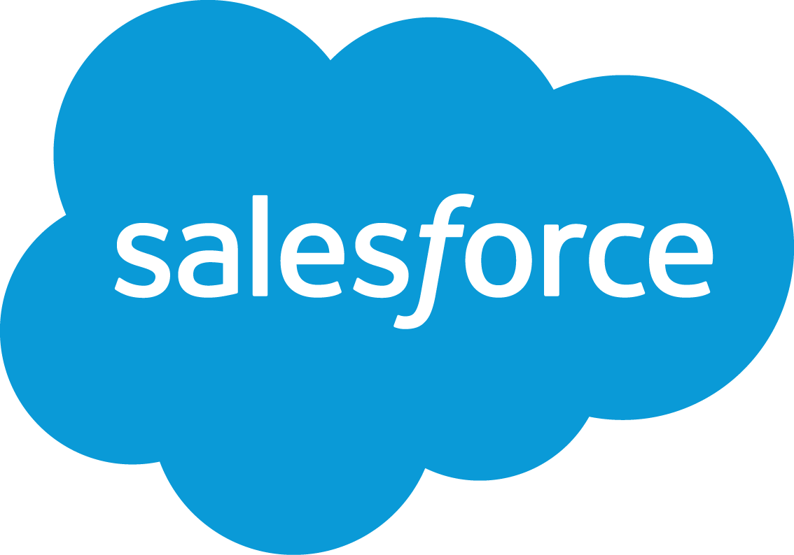
Cody Alan Sanders Salesforce Platform Applications Engineer

Slide 2
Agenda
What is Salesforce?
Products
Programmatic Functionality
Additional Features
Industry Uses
Fun Things I Can’t Explain in 15 se...

Slide 3
salesforce.com
Enterprise-level Platform as a Service
From Customer Relationship Management to Customer Success Platform
Various product types delivered as ‘Clouds’

Slide 4
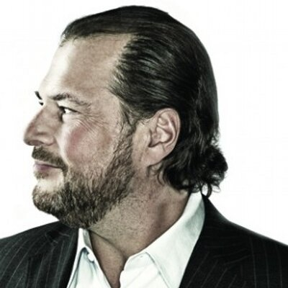

Salesforce Success
Marc Benioff, CEO
- Fortune’s 50 Smartest in Tech - President Bush’s IT Advisory
- Ranked Top 25 Most Effective Philanthropists by Barron’s
Salesforce Ranked #1
2011 2012
2013 2014

Slide 5
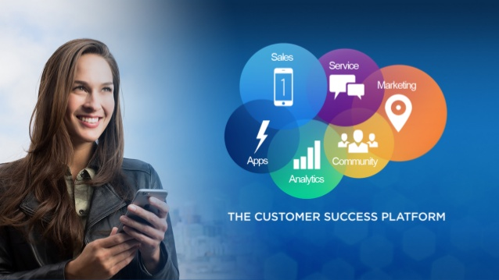
Customer Success Platform

Slide 6
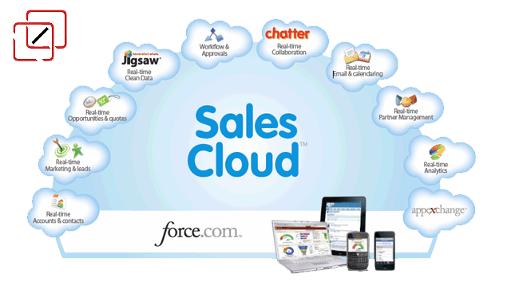
Sales Cloud
Automates entire sales process from the initial lead into opportunities and accounts.

Slide 7
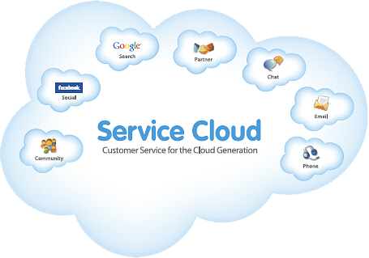
Service Cloud
Designed for call center and self service usage to provides anticipatory and responsive customer service.

Slide 8
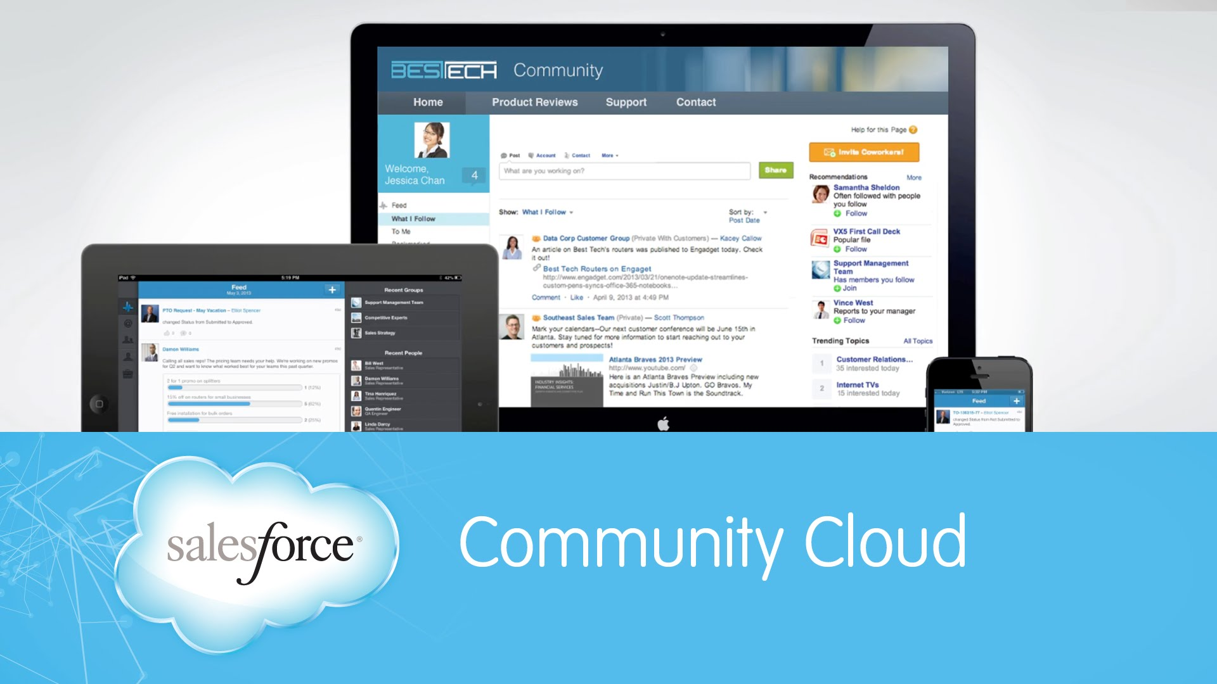
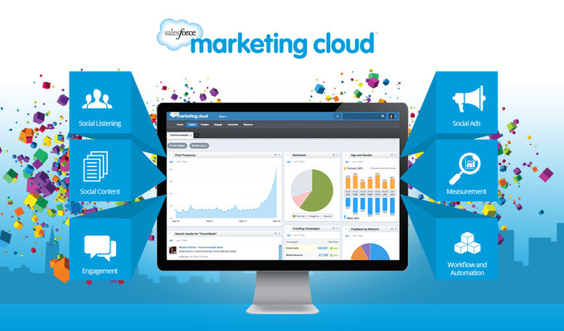
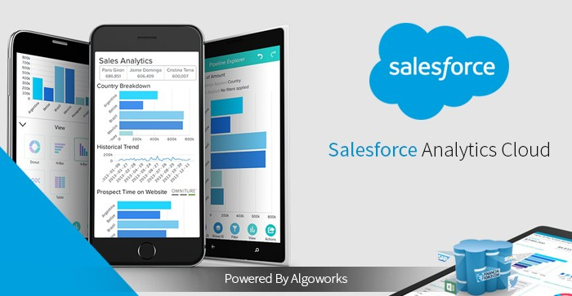
Additional Platforms

Slide 9
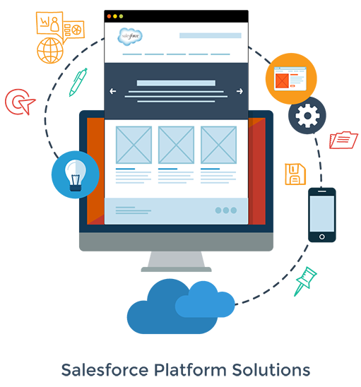
Salesforce Development
Salesforce utilizes proprietary languages to enable developers to fully customize all aspects of their applications.

Slide 10
Platform Languages
Apex
Object-oriented language used for coding Visualforce page controllers, database triggers and add business logic.
Visualforce
Framework for developing custom user-interfaces that adhere to the standard Salesforce interface or an original layout.

Slide 11
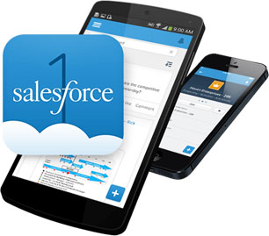
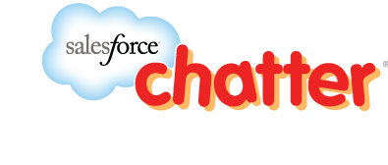
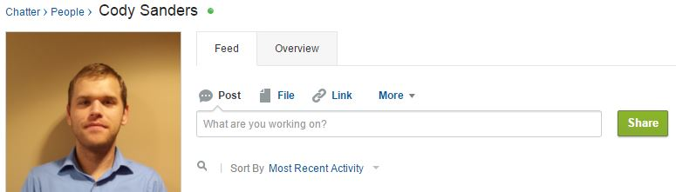
Features: Salesforce Everywhere

Slide 12
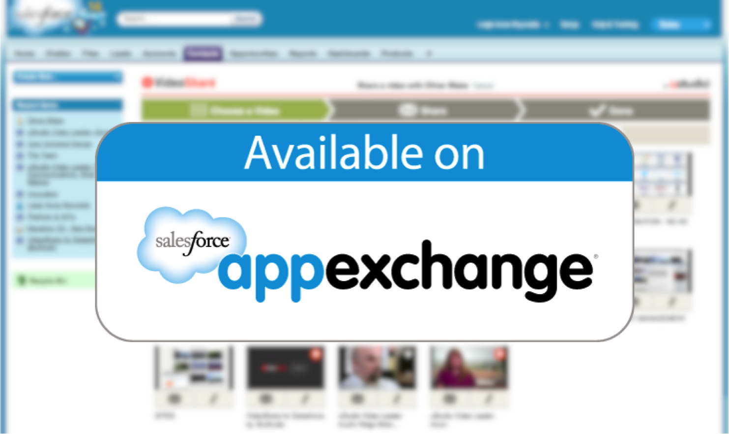

Features: The DRY Principle

Slide 13









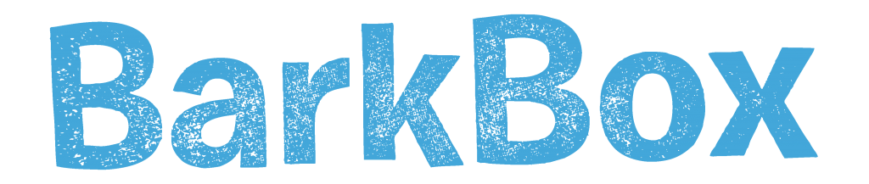


Salesforce Customers

Slide 14
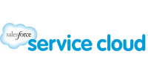

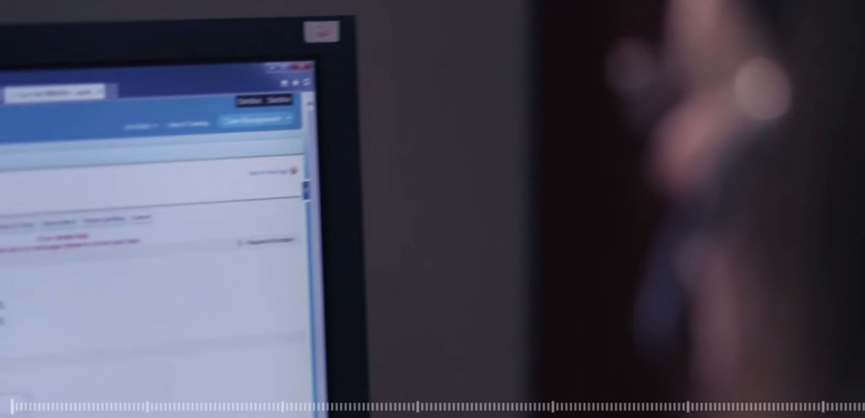
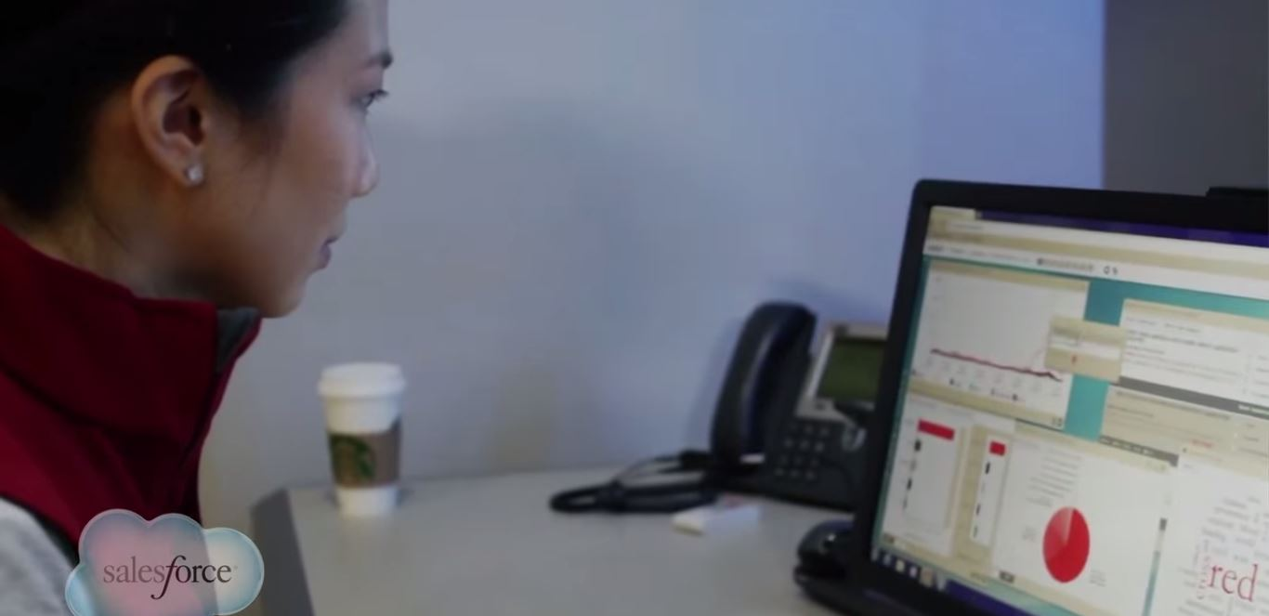

Slide 15
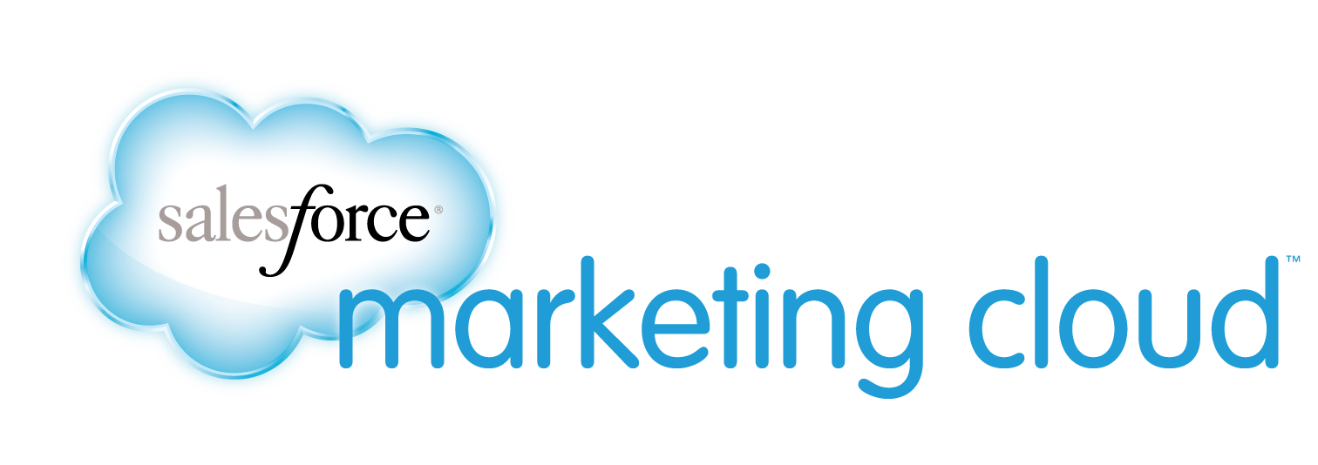

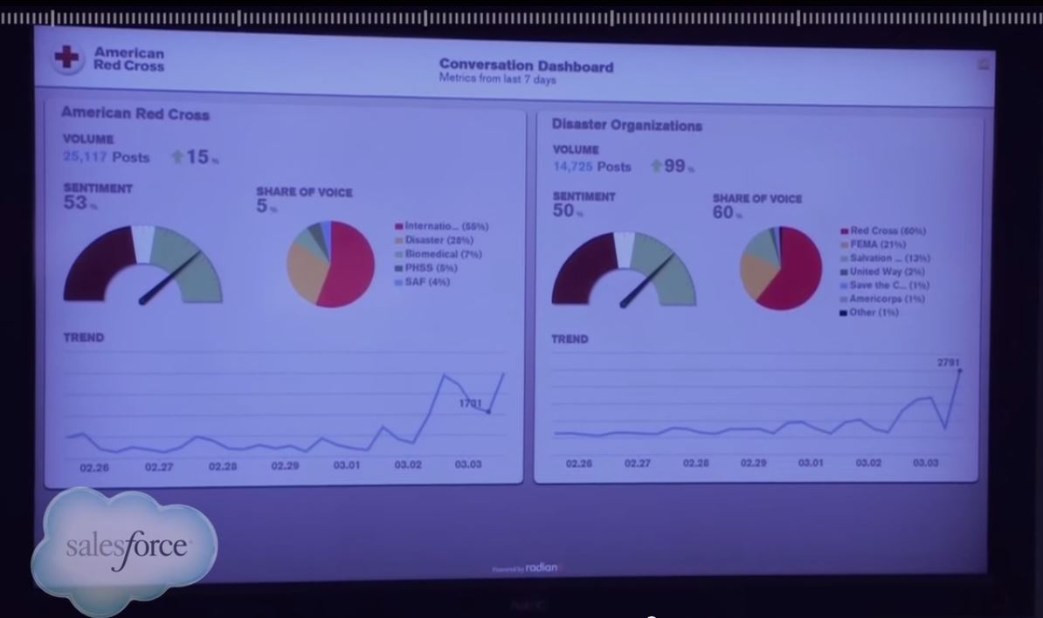

Slide 16

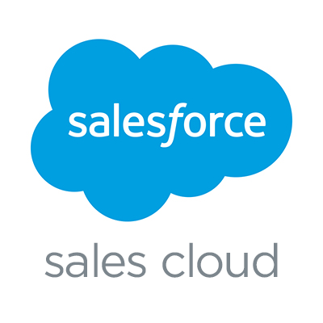
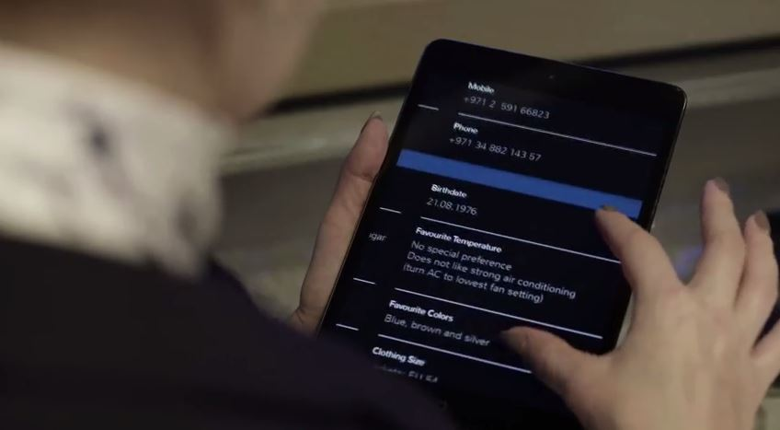
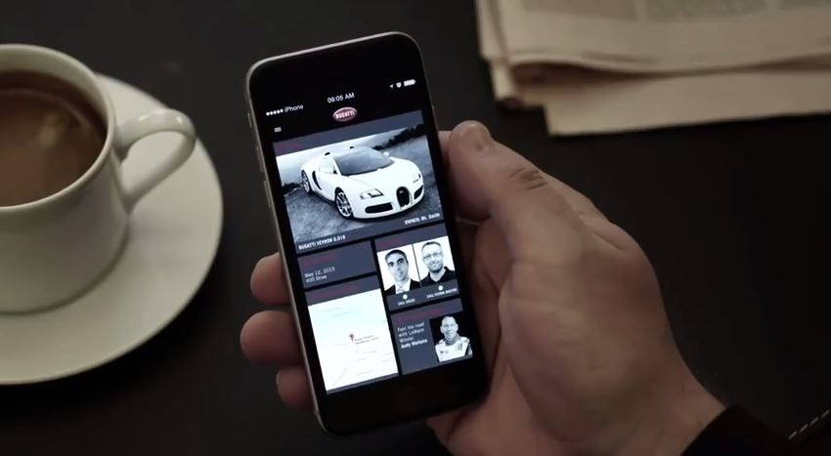

Slide 17
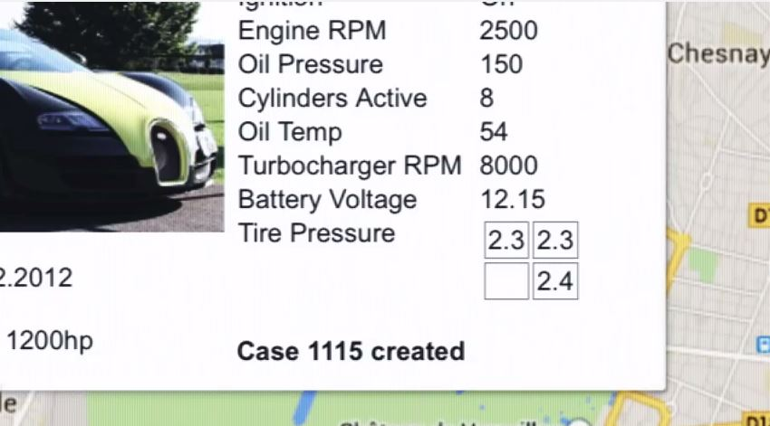
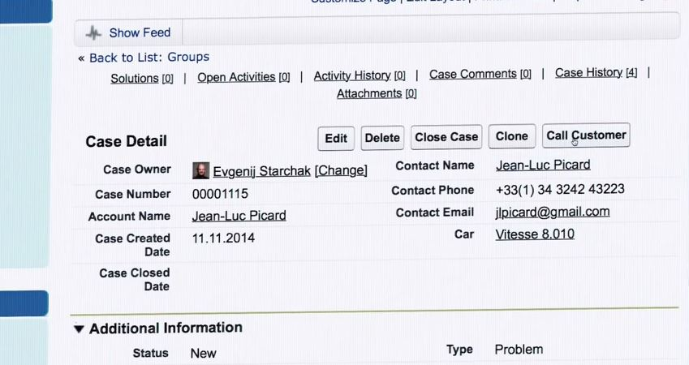

Slide 18
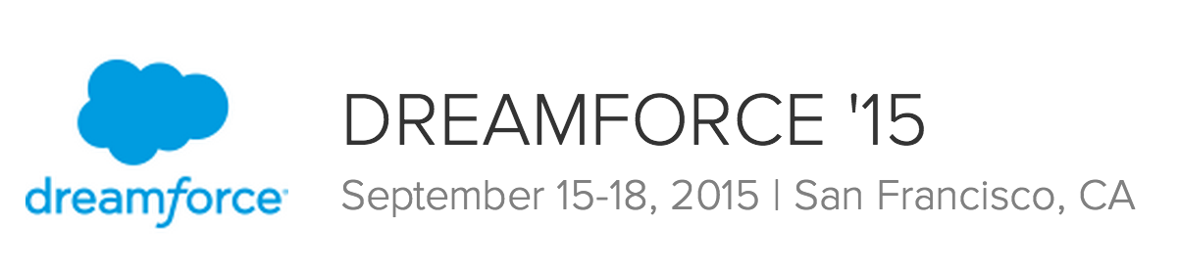
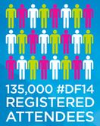



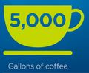
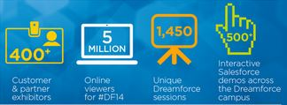
World’s Largest Software Convention

Slide 19
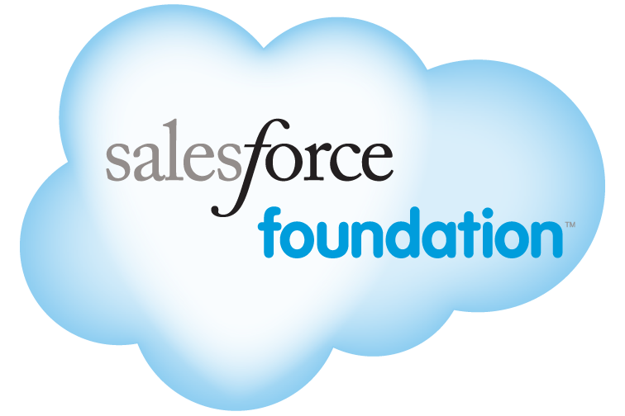
Philanthropy
1% of People · 1% of Technology · 1% of Resources

Slide 20

Thank you for your 5 minutes.

